Slide 1
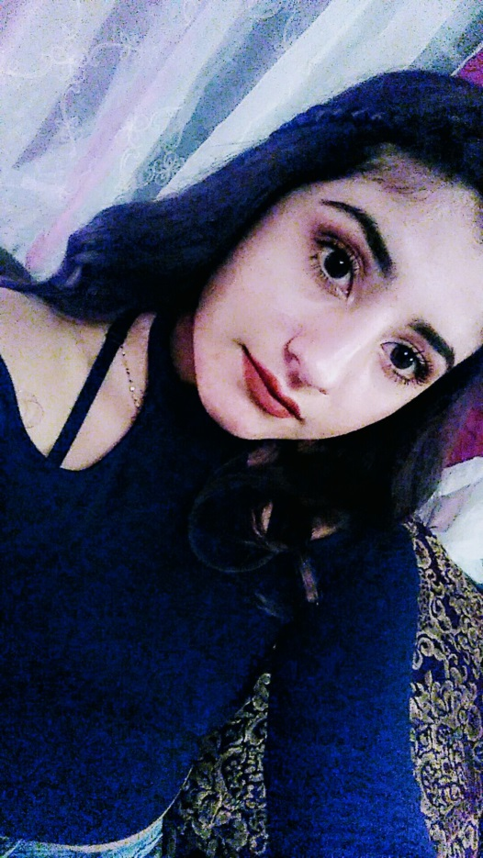
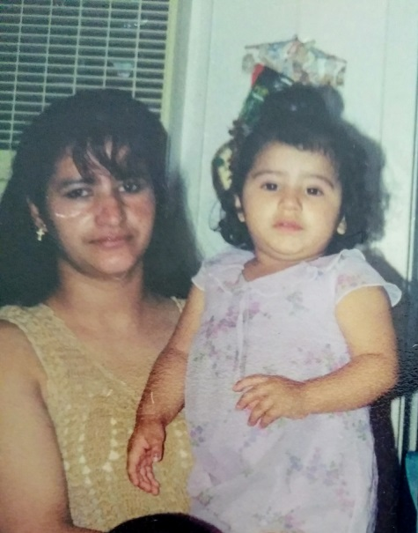
Daisy Aguilar
Class of 2017

Slide 2
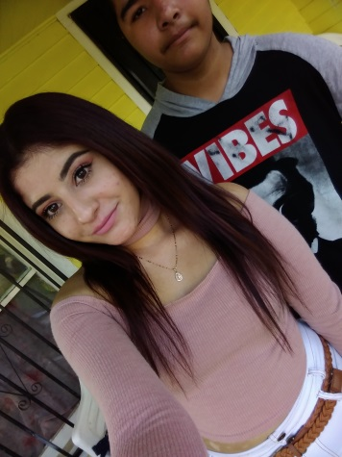
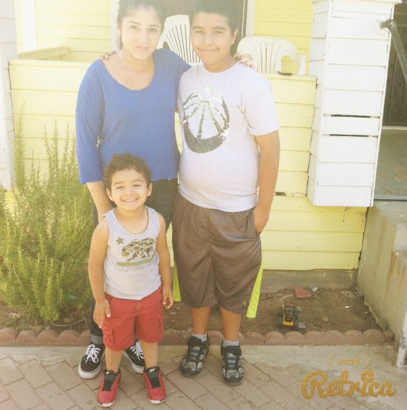
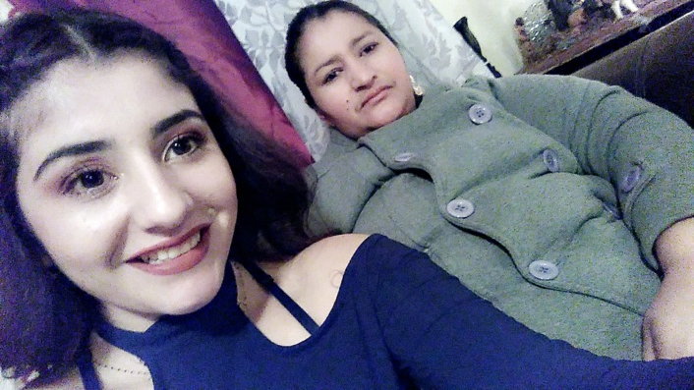
About me
Born September 27,1999 and raised in Lindsay
Oldest of 2 younger siblings
- middle one is 12
- the youngest is 5
Special talents
- Write lyrics (Spanish)

Slide 3
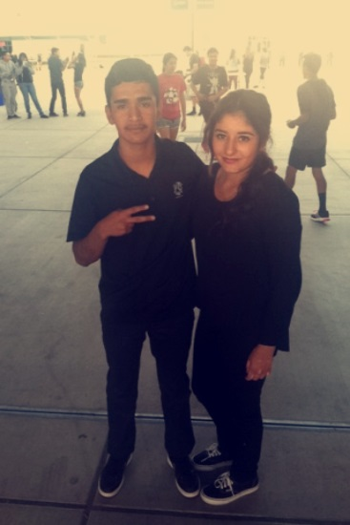
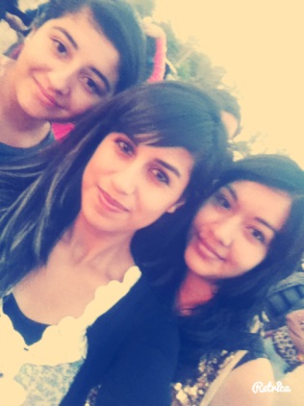
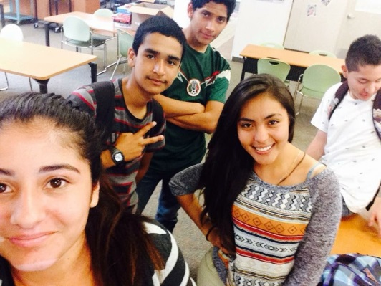
high school experience
Meet new people
- every year I meet new friends
- meet good staff members
Fun moment
- rallies with friends
- extended lunch days
Performanced Based System (PBS)
- Helped me stay on pace
- work on your own (help when needed)
- Meet deadlines

Slide 4
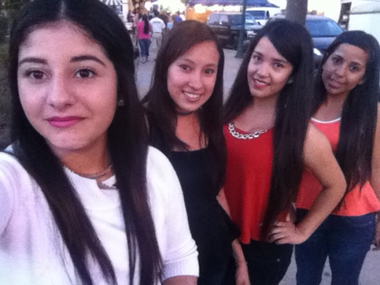
Hobbies
Writing in my notebook
- keeps me busy
- write songs
- make up stories
Hanging with friends and family
- create unforgettable memories
Doing exercise
- improves bone health
-reduces risks of getting sicknesses

Slide 5
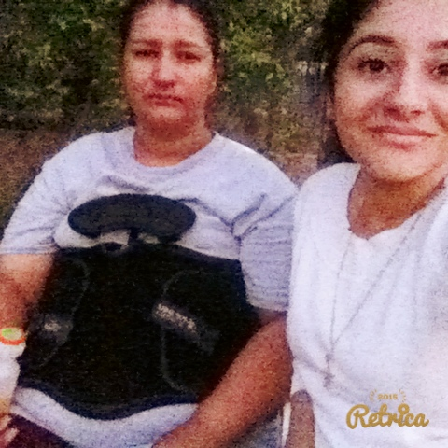
Challenges
Finishing classes freshmen year
- wasn’t familiar with grading
Family tragedy
- mom in hospital over 2 months
- started junior year bad
- all responsibilities left on me
- school was in my way
- always stressed
- counselor helped and modified schedule

Slide 6
Clubs and activities
Didn’t join many because I’m not a social person
CNA program
- finished 1st semester
Red Zone
- involved in for 2 years
- finished homework
- got help from leaders
FBLA
- joined only for freshmen year
- learning dress code
- learning about the conferences

Slide 7
Job shadow
Alicia Soto
- cosmetology
- looked hard because you stand all day
- my side job
- enjoyed it
- fits my personality
- I like doing this

Slide 8
pathway
Health career
- took all classes required
- learned more about the medical field
After high school
- going to COS
- obtain my AA degree

Slide 9
Leaving high school
More productive in school
More focused and more organized
Thankful to all my teachers and counselors

Slide 10
Thank you any questions?

